Slide 1

Application Delivery Fundamentals
Parameswari Ettiappan

Slide 2
Goals
BPMN
DMN Training
BPM & Process Automation
Process Engine
Process Applications
Camunda BPM and Microservices
Tools & Infrastructure
Camunda BPM Docker / Open shift Deployment

Slide 3



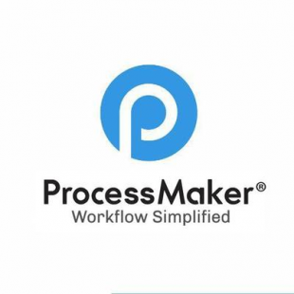






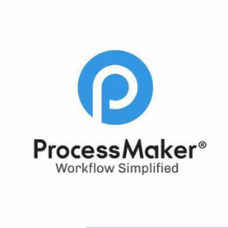


Business Process Management Platforms
Cloud Pak Automation
Bizagi

Slide 4
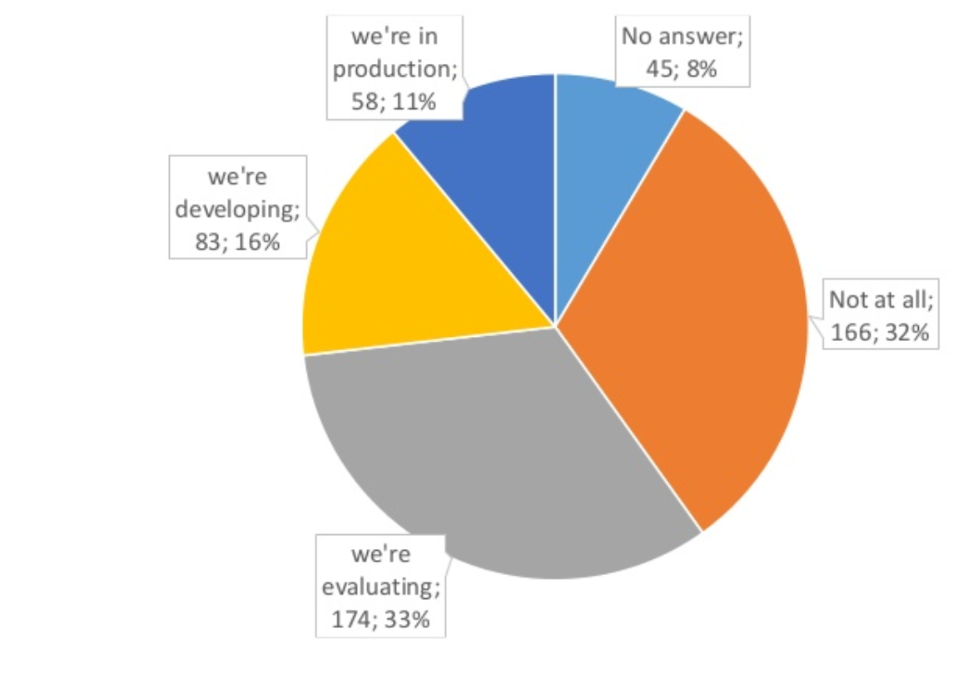
Do you already use Camunda?

Slide 5
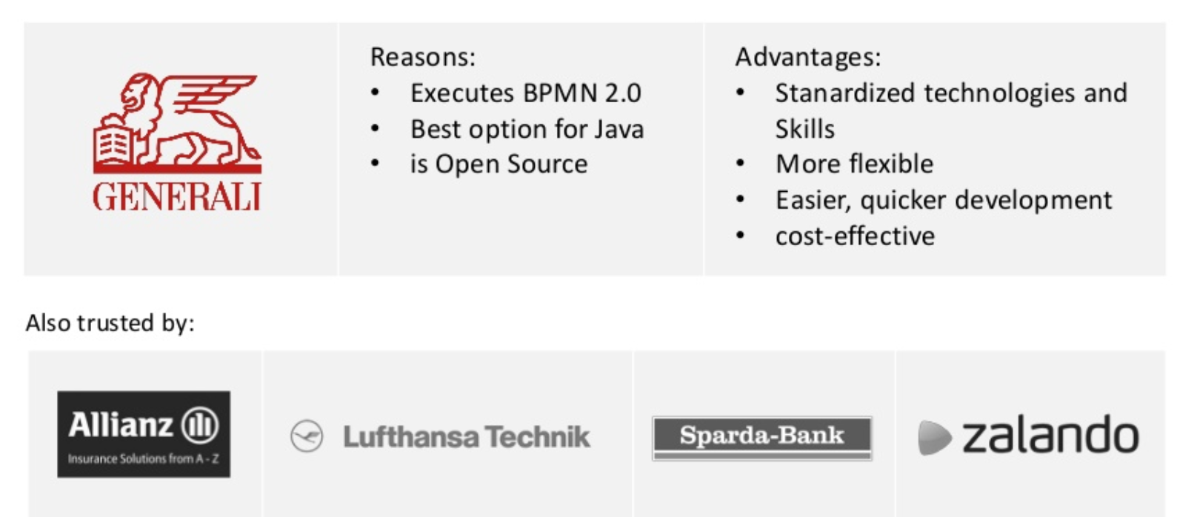
Why do you use Camunda?

Slide 6
Camunda
Camunda BPM platform is a flexible framework for workflow and process automation.
It has a core native BPMN 2.0 process engine that runs inside the Java Virtual Machine.
It can be embedded inside any Java application and any Runtime Container and does not require a lot of processing power.

Slide 7
Camunda Overview
Camunda Platform is a complete process automation tech stack with powerful execution engines for BPMN workflows and DMN decisions paired with essential applications for modeling, operations, and analytics.
With a clear vision to automate any process, anywhere, Camunda is reinventing process automation for the digital enterprise.
Featuring a developer-friendly, open-source approach, enterprises can use Camunda Platform to breakthrough technological, organizational, and infrastructure...

Slide 8
Pega Overview
Pega BPM is a low-code application platform.
It is a world-class Case Management and BPM tool trusted by many major business enterprises.
It provides an extensive number of features for diverse technical and business solutions.
The go-to-market (GTM) using Pega software is faster compared to traditional software development processes.
Pega Robotic Process Automation (RPA) plays a significant role to increase ROI.

Slide 9
Case Management
Case Management feature is strongest in Pega BPM because it provides a seamless process to capture any new case types, design different stages, steps in each stage, design data model, design user interface, and test it.
Camunda requires a good level of technical expertise to implement a real enterprise business use case.

Slide 10
Business User Friendliness

Slide 11
Business User Friendliness
PEGA BPM comes second place since this requires technical expertise to implement a solution.
Camunda is a developer-friendly tool and limited.
Java expertise comes in handy to design and develop an end-to-end enterprise solution.

Slide 12
Architecture/Developer/Designer perspective

Slide 13
Architecture/Developer/Designer perspective
Pega BPM, though it has extensive features provided, it requires individual expertise and multiple levels to manage a project.
It adds complexity which in turn needs a developer to invest more time in learning.
Developing PEGA BPM resources would be much costlier than Camunda.
Camunda would take 2nd place as compared to PEGA BPM.

Slide 14
General Features

Slide 15
A Successful Investment in BPM Needs

Slide 16
Camunda Sample Customers
24 Hour Fitness, Accruent, Allianz Indonesia, AT&T Inc., Atlassian, CSS Insurance, Deutsche Telekom, Generali, Provinzial NordWest Insurance Services, Swisscom AG, U.S. Department of Veterans Affairs...

Slide 17
Pega Sample Customers
The State of Maine, ANZ, Coca-Cola, Department for Environment, Food & Rural Affairs (DEFRA), ME, New South Wales, OptumRx, Texas Department of Transportation, UnitedHealthcare Medicare & Retirement.

Slide 18

Camunda

Slide 19
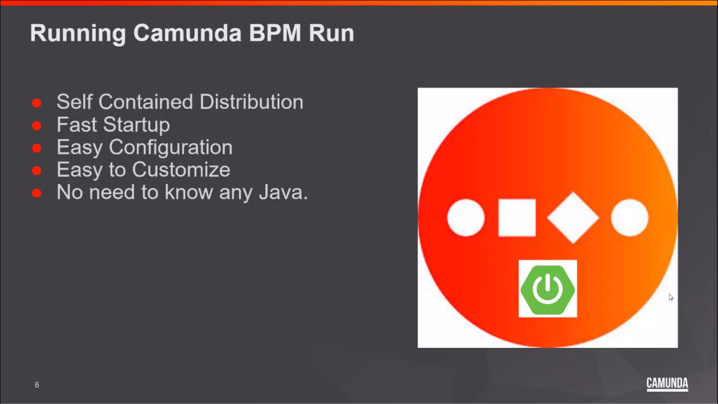
Camunda

Slide 20
Camunda BPM Run

Slide 21
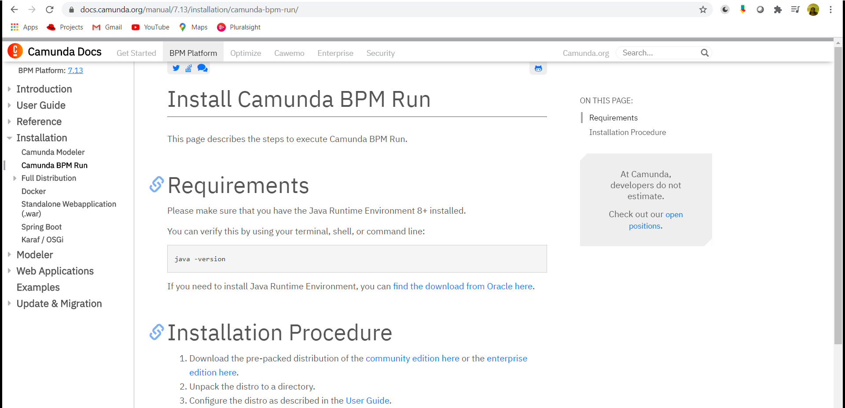
Camunda Installation

Slide 22
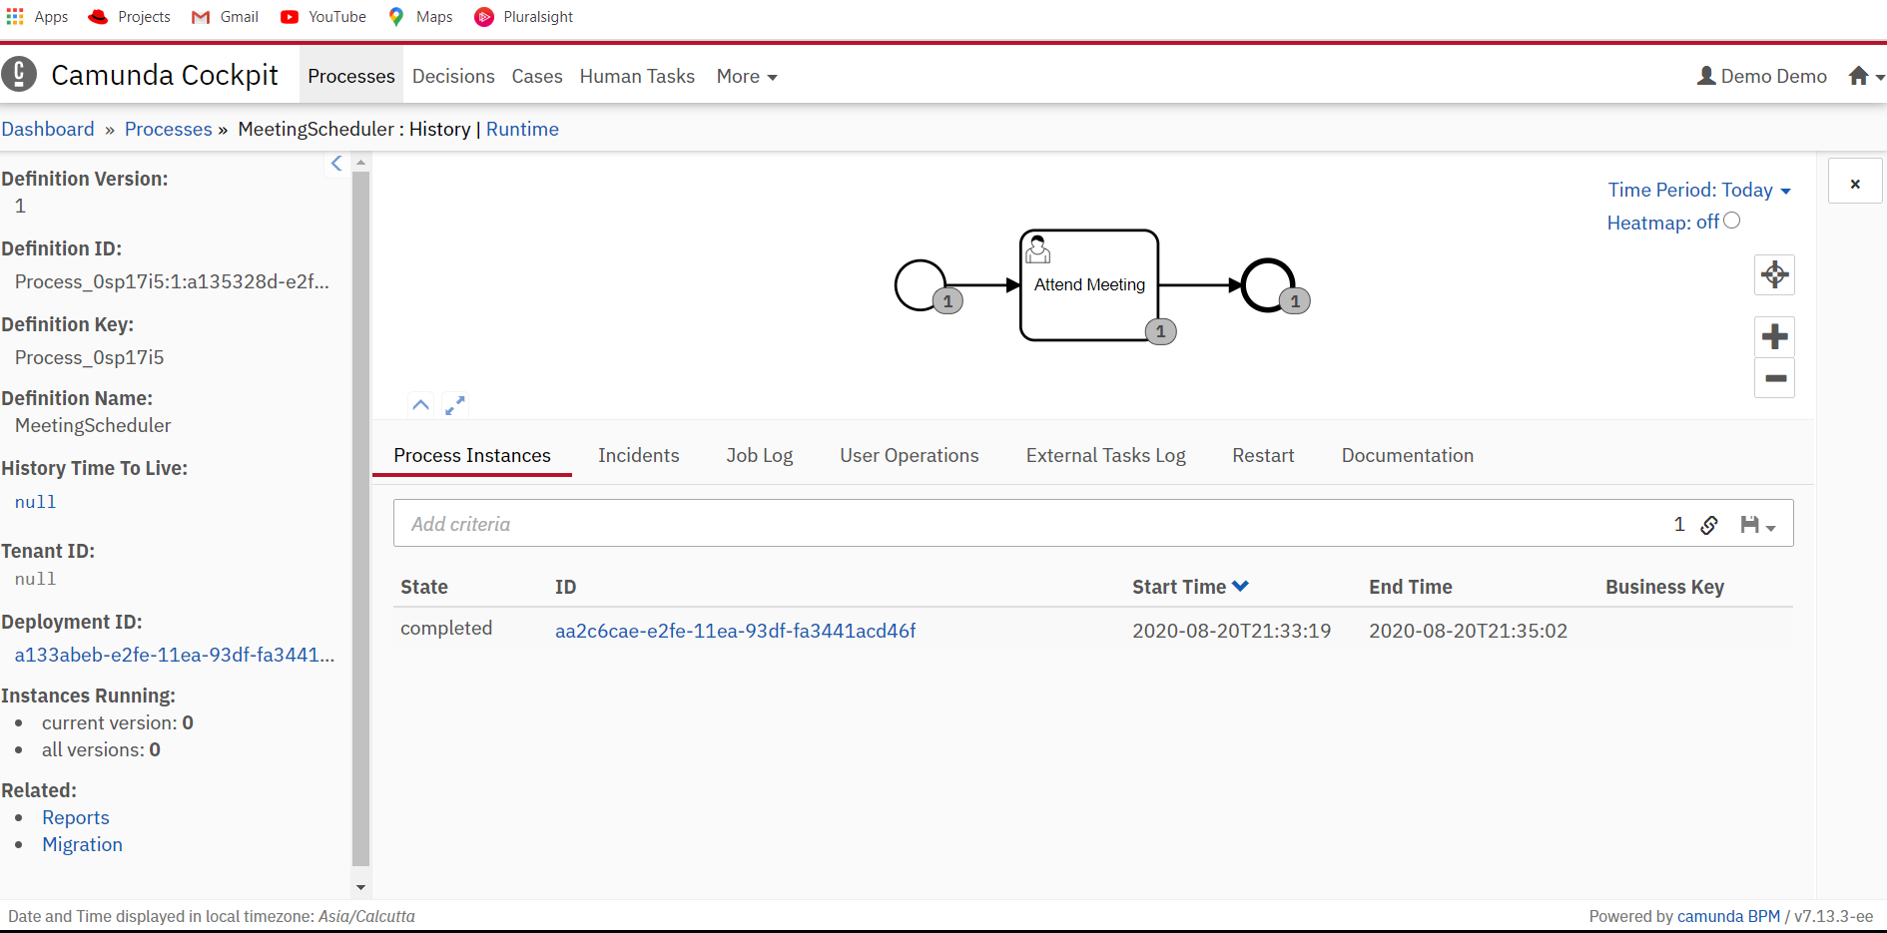
Camunda Installation

Slide 23

https://start.camunda.com/

Slide 24
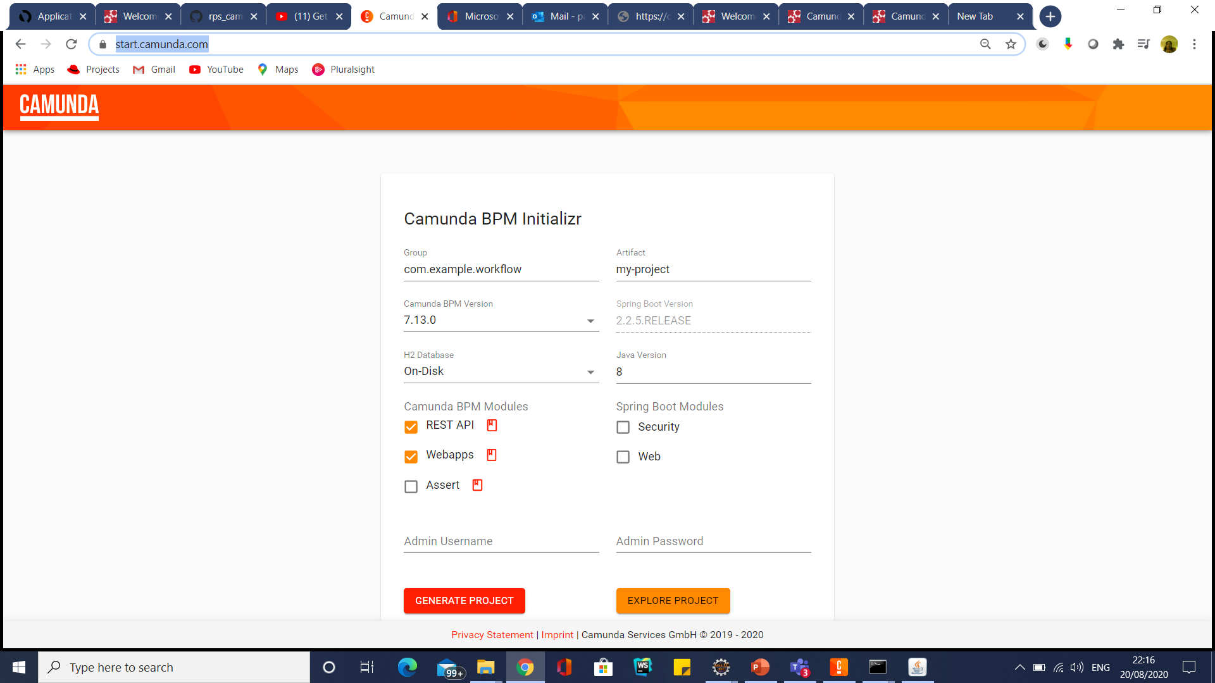
Spring Boot Integration

Slide 25
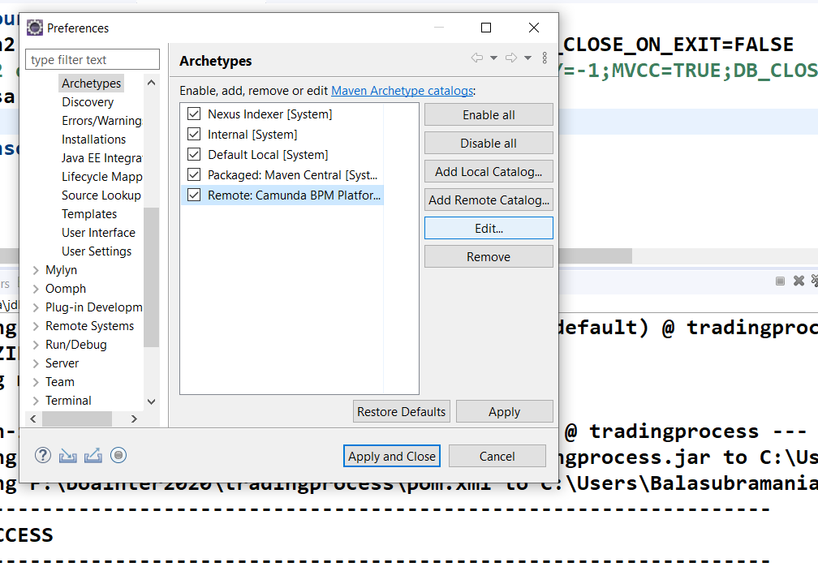
Usage in Eclipse IDE

Slide 26
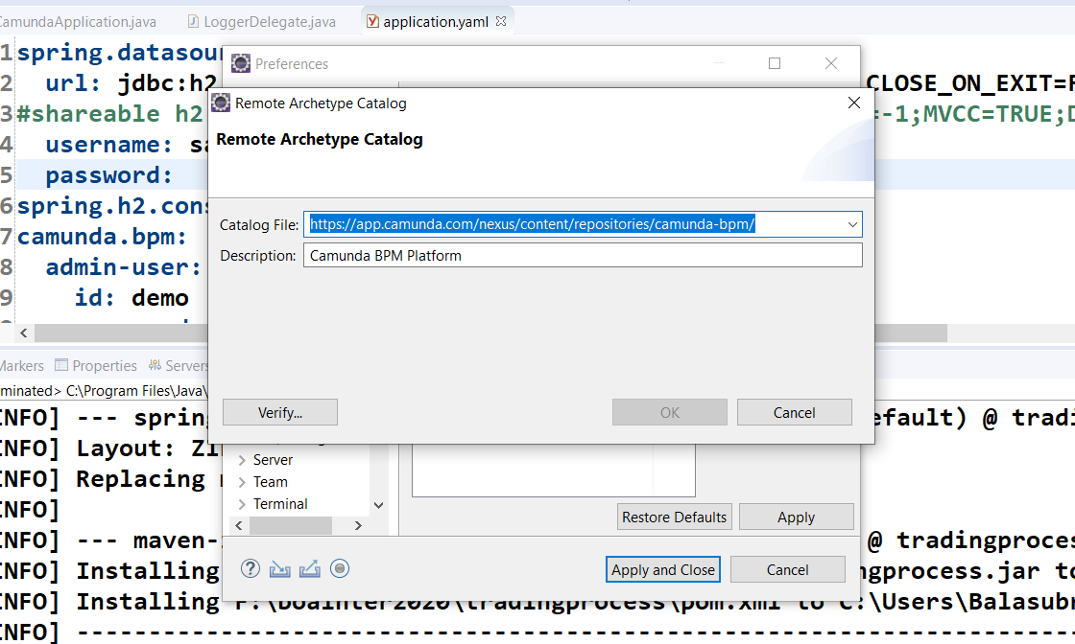
Usage in Eclipse IDE
https://app.camunda.com/nexus/content/repositories/camunda-bpm/

